Slide 1


Programming in Java, 2e
Sachin Malhotra
Saurabh Choudhary

Slide 2
Chapter 13
Event Handling In Java

Slide 3
Objectives
Understand event delegation model
Understand what are events, sources, and listeners
Know about their event classes and associated listeners
how basic events are handled (in applets)
learn three ways of event handling: Listeners, Adapters, and Inner classes

Slide 4
Introduction
We have done enough of objects and classes by now.
An object resides in a particular state until it is made to transit to other state.
This transition occurs due to an event.
For example, we want an object to invoke a function when an action is generated, e.g.
  pressing a key on the keyboard,
  moving the mouse,
  clicking on a button, etc.
The object which generates the event, i.e. the source of the event is known as the event generator.

Slide 5
Introduction
The object, responsible for performing the task when an event occurs is called the event handler.
  There may be more than one event handlers for one single event generated.
How do these handlers know that a particular event has occurred so that they can perform their activity?
There is a registration process, undertaken by the event object, for each of its event handlers.
This registration involves the event handler simply asking the event generator to inform about the occurrence of an event.
By registering, the event generator is able to keep track of all the registered event handlers.

Slide 6
Event Delegation Model
In Event Delegation Model, a source generates events which are sent to one or more listeners.
The listeners receive the event, and process them.
The processing logic applied for handling an event is totally segregated by the logic that generates the event, i.e. the event-generating component can be designed differently than the event-processing component.
Actually the event generating component delegates the responsibility of performing an event-based action to a separate event-performing component.
The model has three dimensions, namely events, event sources and event listeners.

Slide 7
Event Delegation Model
An event is an object that describes a state change in the source.
It may be generated directly because of interaction with the components of GUI environment or any other reason such as expiry of timer, completion of an operation, etc.
An event source is an object which generates the event. Generation of event must cause a change in the state of the source. A source can generate more than one event.
Event Listeners are the objects that get notified when an event occurs on an event source.

Slide 8
java.awt.AWTEvent
The java.awt.AWTEvent class is the root class for all AWT Events.
java.awt.event packages includes the definition of events classes, listeners interfaces, and adapters classes, which from the basics for event handling.

Slide 9
Event classes
Java has a predefined hierarchy of event-related classes, at the root of which is EventObject.
It is actually a member of java.util package. This class has constructors and methods defined as its members.
One such constructor is EventObject(Object src_obj)
  where, src_obj is the object, which generates the event.
EventObject has methods like getSource() and toString().
  getSource() – returns the source of the event
  toString() – returns the string equivalent of the event

Slide 10
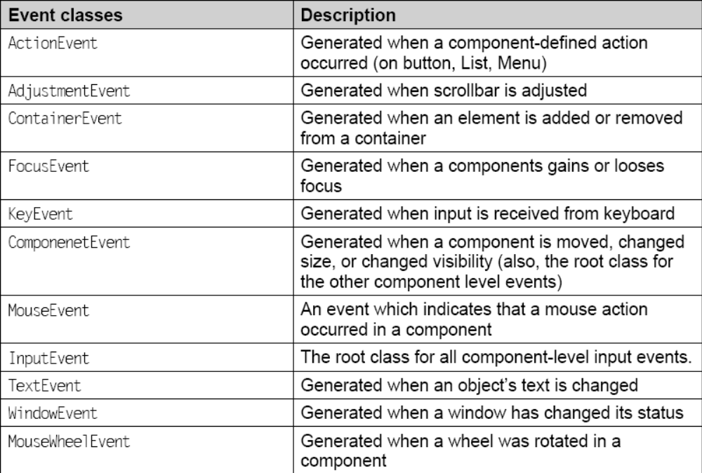
Event Classes (contd.)

Slide 11
ActionEvent
This event is generated by a component (such as a Button) when the component-specific action occurs (such as click).
The event is passed to an ActionListener object which is registered to receive the event notification using the component’s addActionListener method.
The object that inherits the ActionListener interface is passed to the ActionEvent when an event occurs. Some of the fields, constructors, and methods associated with the ActionEvent class

Slide 12
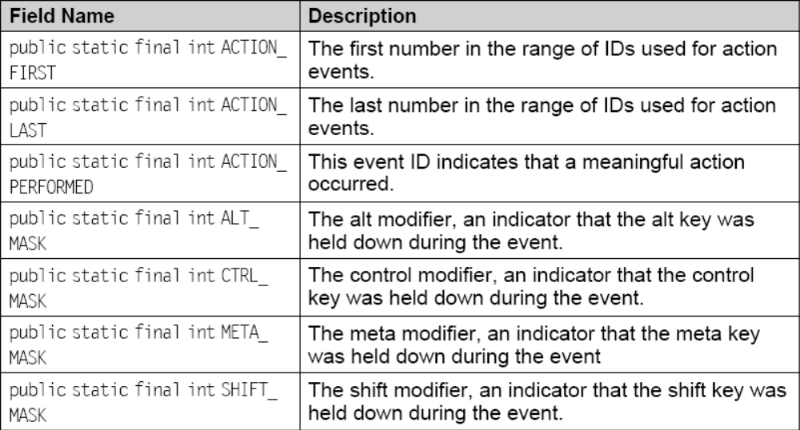
Field Summary of ActionEvent

Slide 13
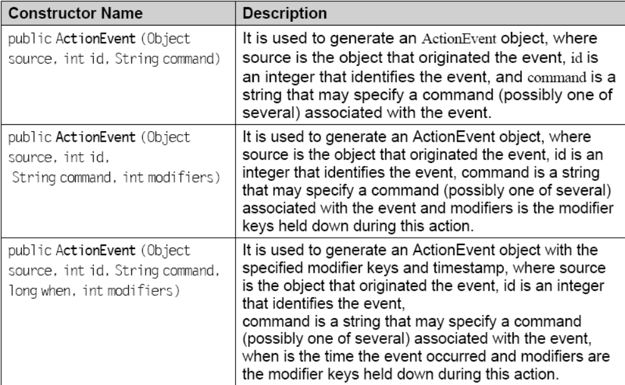
Constructor of ActionEvent

Slide 14
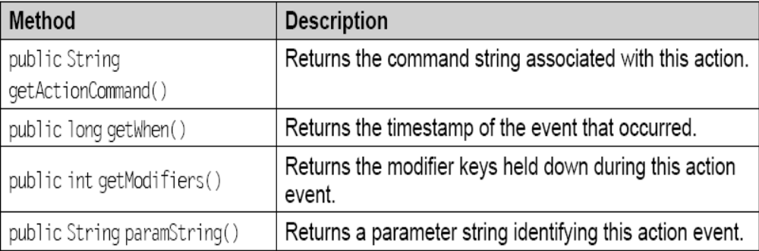
Methods of ActionEvent

Slide 15
AdjustmentEvent
The adjustment events are generated by Adjustable objects like scroll bar.

Slide 16
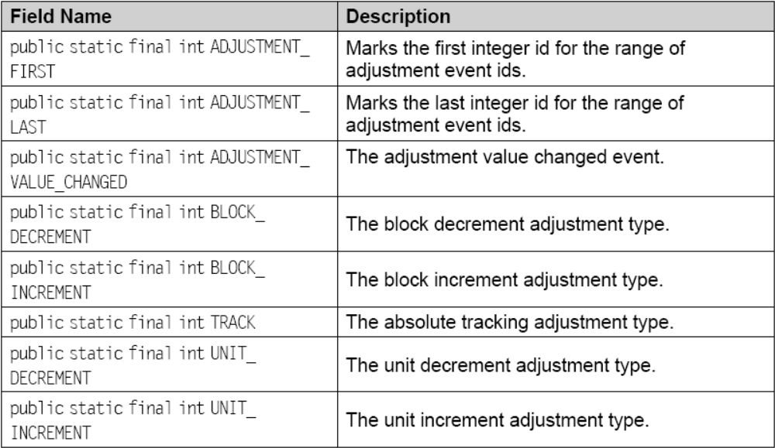
Fields of Adjustment Event

Slide 17
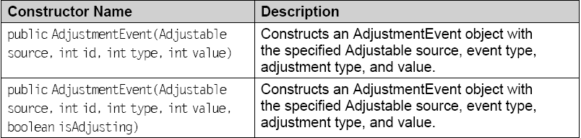
Constructor of AdjustmentEvent

Slide 18
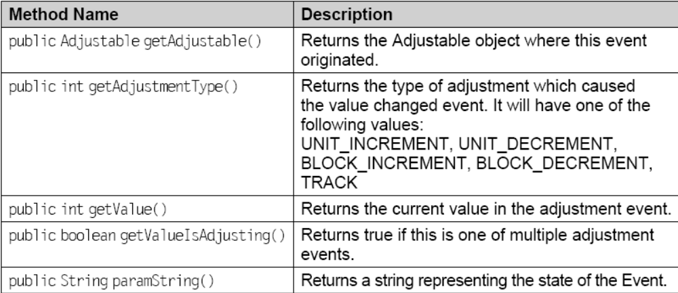
Methods of AdjustmentEvent

Slide 19
KeyEvent
KeyEvent is an event which indicates that a keystroke occurred in a component.
  public class KeyEvent extends InputEvent
is generated by component object (such as a text field, Applet, Frame) when a key is pressed, released, or typed.
The event is passed to a KeyListener object which is registered to receive the event notification using the component’s addKeyListener method.
There can be three types of key events, which are identified by integer constants.
  KEY_PRESSED (it is generated when any key is pressed)
  KEY_TYPED (it is generated if a valid Unicode character could be generated)
  KEY_RELEASED (it is generated when any key is released)

Slide 20
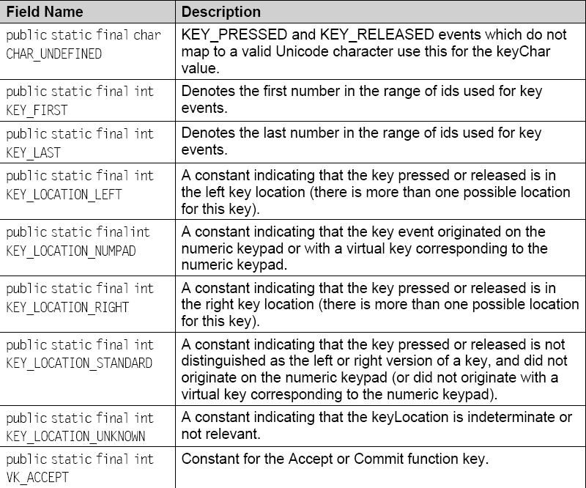
Few Integers constants in KeyEvent

Slide 21
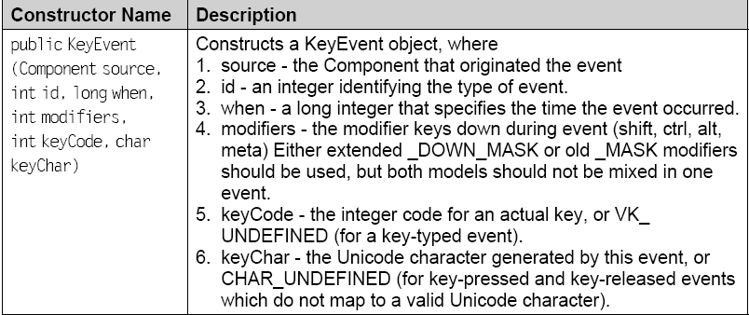
Constructor

Slide 22
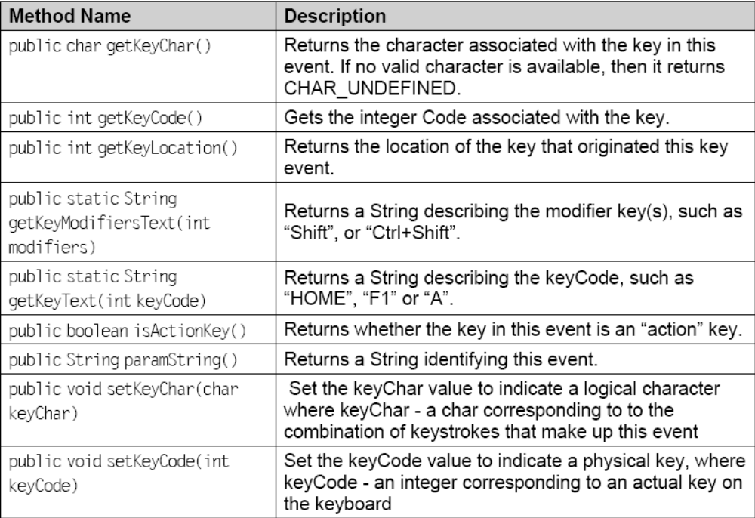
Methods in KeyEvent

Slide 23
MouseEvent
It is an event which indicates that a mouse action occurred in a component.
A mouse action occurs in a particular component if and only if the mouse cursor is over the defined part of the component’s bounds when the action happens.
  public class MouseEvent extends InputEvent
There are eight types of mouse events defined in the MouseEvent class.
The MouseEvent class defines them as integer constants to identify each of these events.

Slide 24
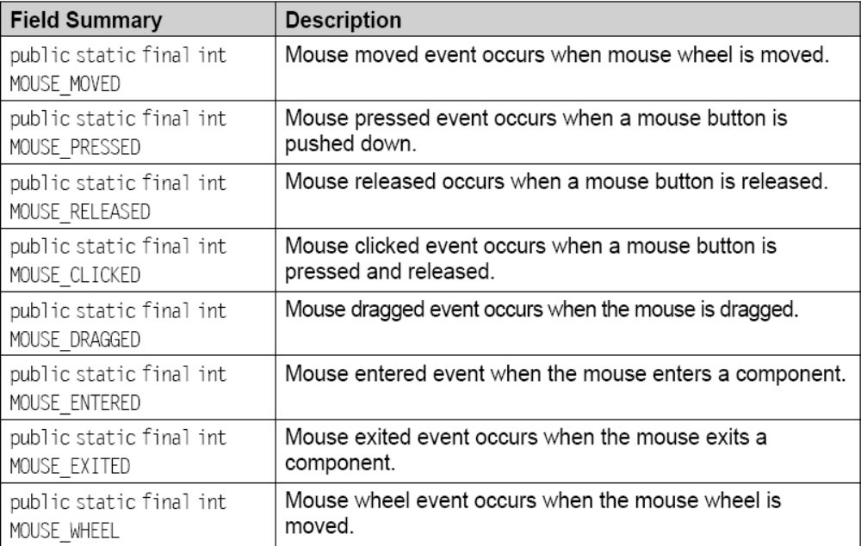
Fields of MouseEvent

Slide 25
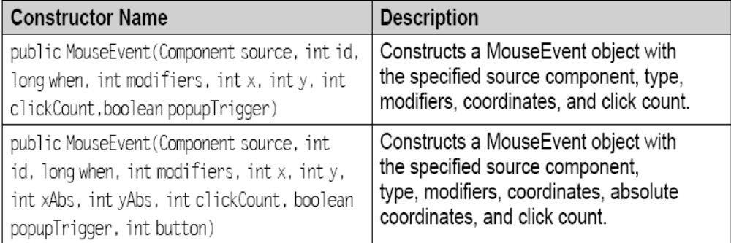
Constructors of MouseEvent

Slide 26
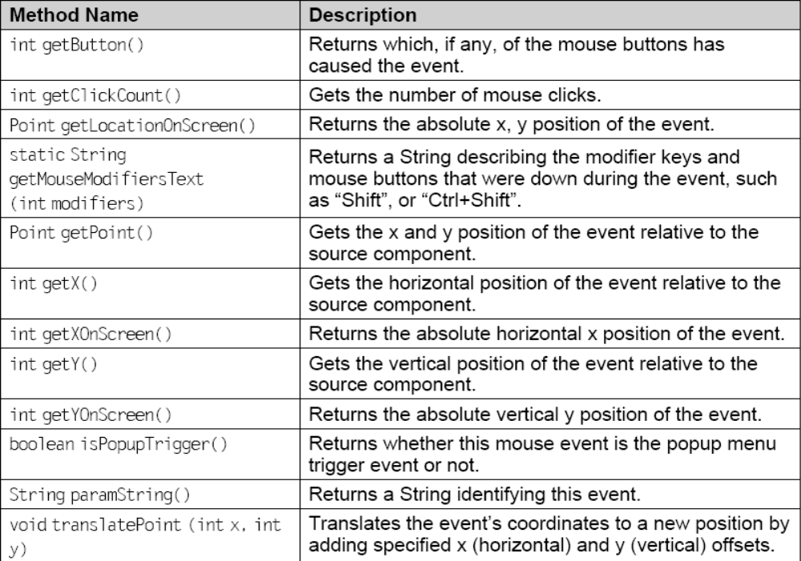
Methods of MouseEvent

Slide 27
FocusEvent
This event is generated when a component gains or loses focus.
There are two types of focus events: permanent and temporary.
  Permanent focus event occurs when the user explicitly changes focus from one component to other, e.g. by pressing tab key.
  Temporary focus event occurs when the focus is lost due to operations like Window deactivated. In this case, when the window will again be activated, the focus will be on same component.

Slide 28
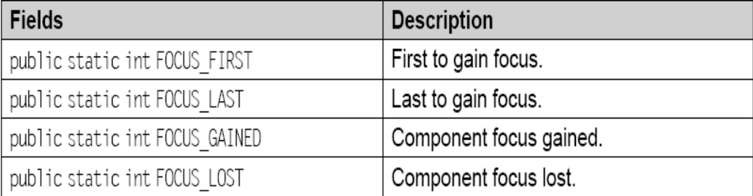
Fields of FocusEvent

Slide 29
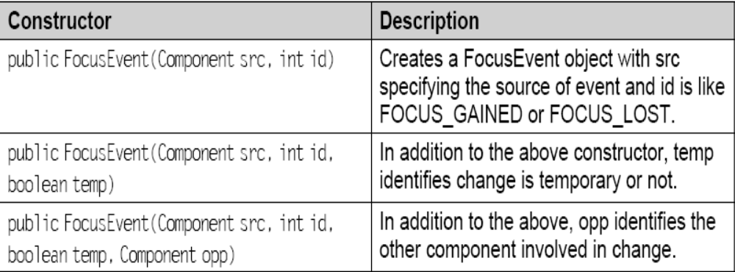
Constructor of FocusEvent

Slide 30
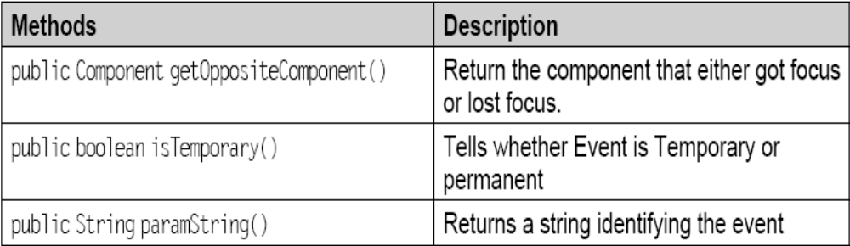
Methods of FocusEvent

Slide 31
ItemEvent
It is an event which shows whether an item was selected or de-selected.
  public class ItemEvent extends AWTEvent
This event is generated by an ItemSelectable object (such as a List), where the event is generated when an item of the list is either selected or de-selected.
The event generated is passed to every ItemListener object which is registered to receive such events.
The method addItemListener() is used for this registration process.

Slide 32
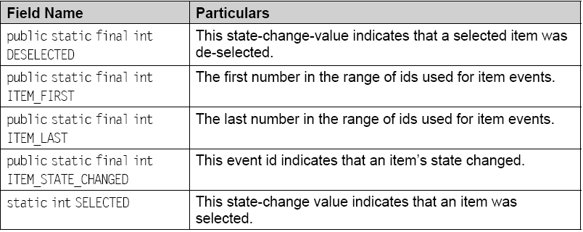
Fields of ItemEvent

Slide 33
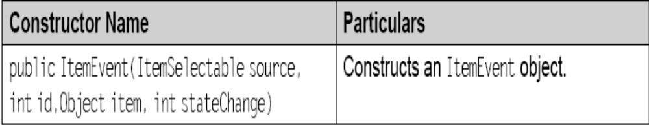
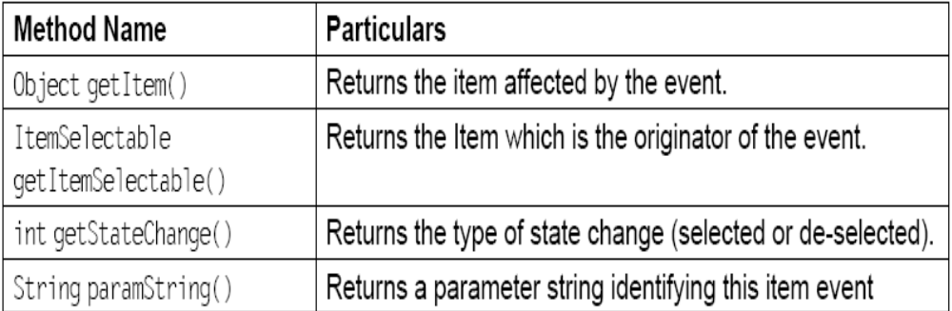
ItemEvent (contd.)

Slide 34
TextEvent
This event indicates the change in the object’s text.
  public class TextEvent extends AWTEvent
This event is generated by an object (such as a TextComponent) whenever its text changes. The event is passed to every TextListener object which is registered to receive such events.
The method addTextListener() is used for this registration process.

Slide 35
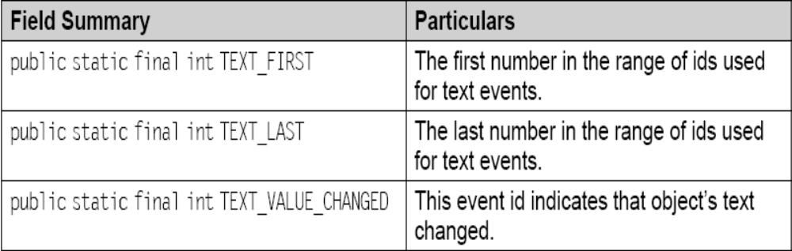
TextEvent (contd.)

Slide 36
Source of Events
Button
Choice
MenuItem
List
Checkbox
Window
Scrollbar
Text Components

Slide 37
Source of Events
Event Listeners are created by implementing one or more interfaces defined by the java.awt.event package.
Whenever a source generates an event, it basically invokes the appropriate method defined in the listener interface.
The method has a event object passed as an argument to it.

Slide 38
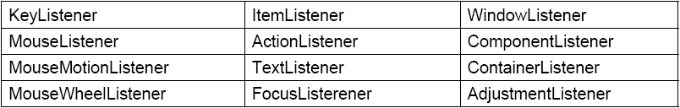
Listeners

Slide 39
KeyListener
This interface has three methods defined within it.
  void keyPressed(KeyEvent e) – invoked when a key is pressed
  void keyReleased(KeyEvent e) - invoked when a key is released
  void keyTyped(KeyEvent e) - invoked when a character is typed

Slide 40
MouseListener
The interface has five methods, having the signatures as follows:
  void mouseClicked(MouseEvent e)
  void mouseEntered(MouseEvent e)
  void mousePressed(MouseEvent e)
  void mouseReleased(MouseEvent e)
  void mouseExited(MouseEvent e)

Slide 41
MouseMotionListener
The interface has two methods having the signatures,
  void mouseMoved(MouseEvent e)
  void mouseDragged(MouseEvent e)
mouseMoved() is invoked when the mouse is moved from one place to another and mouseDragged() is used when the mouse is dragged.

Slide 42
MouseWheelListener &
ItemListener
MouseWheelListener has only one method, having the signature,
  void mouseWheelmoved(MouseEvent e) - invoked when the mouse wheel is moved.
ItemListener has only one method defined as,
  void itemStateChanged(ItemEvent e) - invoked when the state of the item changes.

Slide 43
ActionListener, TextListener & FocusListener
ActionListener has only one method
  void actionPerformed(ActionEvent e) - invoked when any action event is performed.
TextListener has only one method
  void textChanged(TextEvent e) - invoked whenever there is a change in text field or text area.
FocusListener interface has two methods,
  void focusGained(FocusEvent e) - invoked when the component obtains keyboard focus and focusLost()
  void focusLost(FocusEvent e) - is invoked when the component looses the keyboard focus.

Slide 44
WindowListener
This interface has seven methods
  void windowActivated(WindowEvent e)
  void windowClosed(WindowEvent e)
  void windowClosing(WindowEvent e)
  void windowOpened(WindowEvent e)
  void windowDeactivated(WindowEvent e)
  void windowIconified(WindowEvent e)
  void windowDeiconified(WindowEvent e)

Slide 45
Model
Each source, generating the events must register event listeners to itself, so that listeners get the license for receiving the events from the respective source.
Each type of event has its own registration method, having the form,
  public void addTypeListeners(TypeListener tl)
These listeners, once registered for events from a particular source, can get unregistered also using
  public void removeTypeListener(TypeListerner tl)
Once the listener objects are registered, they must implement the methods to receive and process the event notifications sent by source.

Slide 46
Example (MouseMotionListener)
/*<applet code=”MouseMotionEx.class” width=300 height=300></applet>*/
import java.awt.*; import java.applet.*;
import java.awt.event.*;
public class MouseMotionEx extends Applet implements MouseMotionListener {
int xcord; int ycord;
public void init(){ addMouseMotionListener(this); }
public void paint(Graphics g){
g.drawString(“(“+xcord+”,”+ycord+”)”,xcord,ycord);}
public void mouseMoved(MouseEvent me){
xcord = me.getX();
ycord = me.getY();
repaint();}
public void mouseDragged(MouseEvent me){} }

Slide 47
Another way of doing same
/*<applet code = “MouseMotionEx.class” width = 700 height = 700 > </applet>*/
import java.awt.*;
import java.applet.*;
import java.awt.event.*;
public class MouseMotionEx extends Applet
{
int xcord; int ycord;
public void init(){
addMouseMotionListener (new Demo(this));}
public void paint (Graphics g){
g.drawString (“(“+x cord +”, “+y cord+”)”);
}}

Slide 48
Another way of doing same (contd.)
class Demo implements MouseMotionListener
{
MouseMotionEx m;
Demo(MouseMotionEx m)
{
this.m=m;
}
public void mouseMoved(MouseEvent me) {
m.xcord = me.getX();
m.ycord = me.getY();
m.repaint();}
public void mouseDragged(MouseEvent me) {}
}

Slide 49
Adapter classes
In listener interfaces, you have to implement all the methods defined in that interface
This can be annoying at times, particularly when you need to implement methods of the interface, which might not actually be used.
In order to simplify things, Java came up with the concept of adapter classes.
JDK defines corresponding adapter classes for listener interfaces containing more than one methods e.g. for MouseMotionListener, MouseMotionAdapter class has been defined.
Adapter classes provide empty definitions for all the methods of their corresponding Listener interface.
It means that MouseMotionAdapter class inherently implements MouseMotionListener interface.

Slide 50
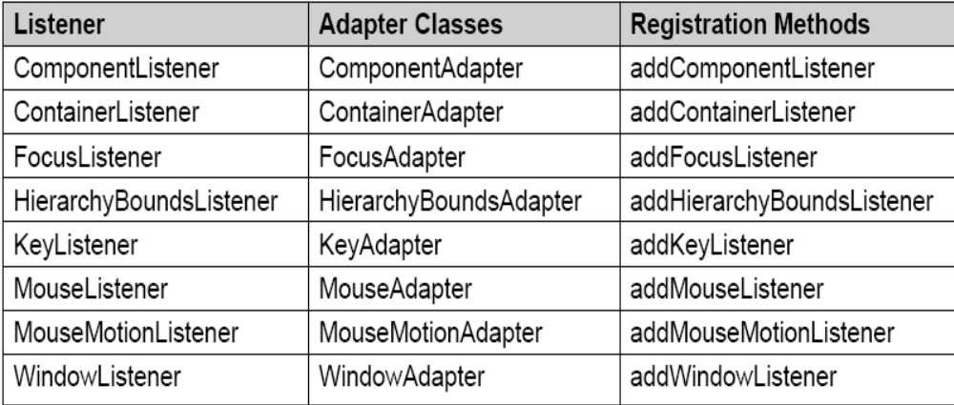
Adapter classes

Slide 51
How to use Adapter classes?
/*<applet code=”AdapterDemo.class” width=300 height=300></applet>*/
import java.awt.*; import java.awt.event.*;
import java.applet.*;
public class AdapterDemo extends Applet {
int xcord,ycord;
public void init(){
addMouseMotionListener(new MouseDemo(this));
}
public void paint(Graphics g){
g.drawString(“(“+xcord+”,”+ycord+”)”,xcord,ycord);
}}

Slide 52
How to use Adapter classes?
class MouseDemo extends MouseMotionAdapter
{
AdapterDemo d;
MouseDemo(AdapterDemo d)
{
this.d = d;
}
public void mouseMoved(MouseEvent me){
d.xcord = me.getX();
d.ycord = me.getY();
d.repaint();
}}

Slide 53
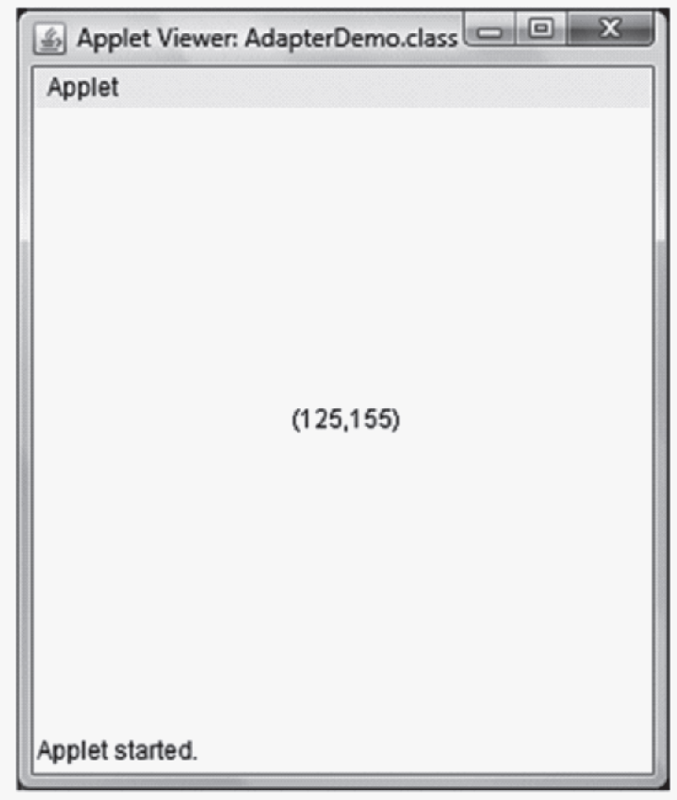
The Output

Slide 54
Inner classes
An inner class can be defined and instantiated all inside a class, or even within an expression.
  member classes,
  local classes, and
  annoymous classes.
Member classes
  are included in the class definition just like fields and methods.
  can either be static or instance.
  Static member class: A member class can be static with access only to the static members of the class to which it belongs.
  Instance member class: A member class can be instance with access to both the static and instance members of the class that contains it.

Slide 55
Inner classes (contd.)
Local classes
  A local class is defined within a code block, typically in a method. An instance of a local class exists only during the execution of the method
Anonymous Inner classes
  An anonymous inner class is one that is not assigned a name.
  Such classes are created on the fly i.e. they are created, instantiated, used and garbage collected when they are done.
  They are automatically assigned a name as Outerclassname$1.
  This anonymity helps in eliminating the unnecessary named objects. Besides, it makes the program more readable.

Slide 56
Use of Member Inner Class
/*<applet code = OuterClass.class width=600 height=600> </applet>*/
import java.awt.*;
import java.applet.*;
import java.awt.event.*;
public class OuterClass extends Applet {
public void init() {
addKeyListener(new InnerClass()); }
class InnerClass extends KeyAdapter {
public void keyPressed(KeyEvent ke) {
showStatus(“key down”); }
public void keyReleased(KeyEvent ke){
showStatus(“key up”); }}}

Slide 57
Use of Anonymous Inner Class
/*<applet code=”AnonyKeyListDemo.class” width=300 height=300> </applet>*/
import java.awt.*;
import java.awt.event.*;
import java.applet.*;
public class AnonyKeyListDemo extends Applet {
public void init(){
addKeyListener(new KeyAdapter(){
public void keyPressed(KeyEvent ke){
showStatus(“Key Pressed”);}
public void keyReleased(KeyEvent me){
showStatus(“Key Released”); }
}); }}

Slide 58
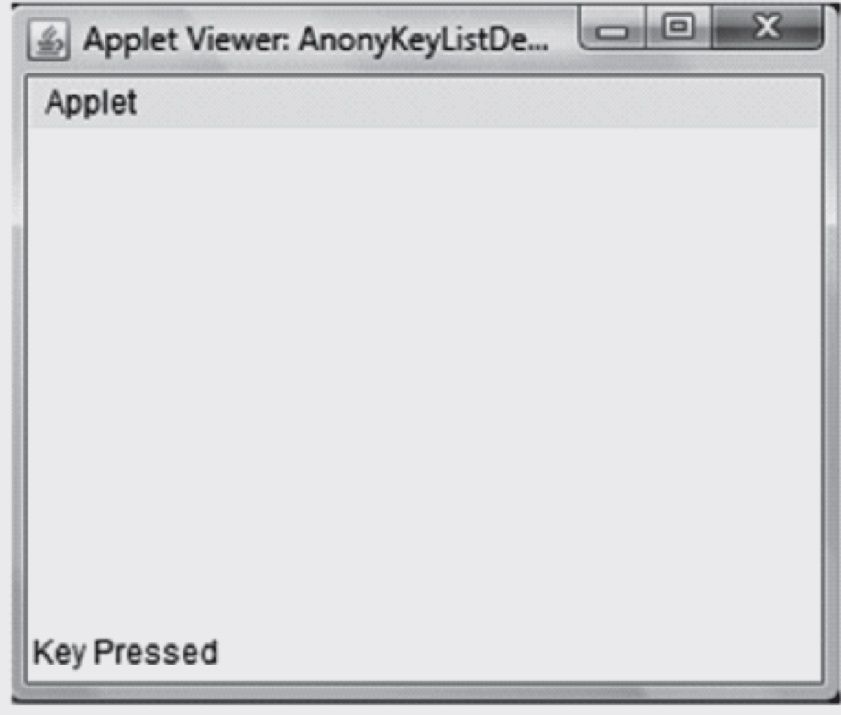
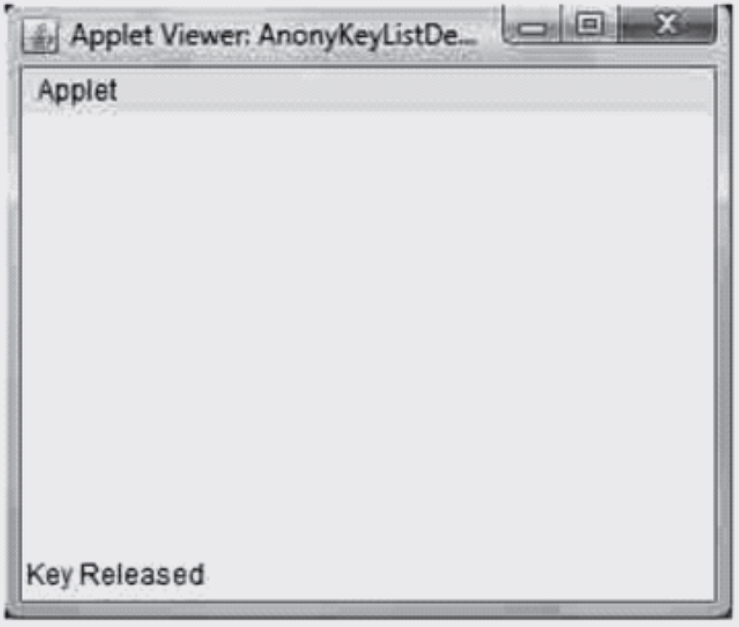
The Output

Slide 59
Summary
In this chapter, we have emphasized on the features that enhance the GUI capabilities of Java by using Event Handling.
Event Handling model has been discussed.
The modern approach to event handling uses Event Delegation Model where a source generates events, which are sent to one or more listeners.
These Listeners receives the event notifications, which are handled as required by the different methods of event classes.
All Three approaches for event handling have been discussed
  Listener interfaces
  Adapter classes
  Anonymous Inner classes

